Slide 1
Murder on the Train: An AI-Powered Interactive Mystery Game
SNU x Upstage LLM 프로젝트 단기강의
옥찬호 박지연 최서호 옥찬호 김유진

Slide 2
Contents
게임 개요
세부사항
코드

Slide 3

Game

Slide 4
Overview
Game Implementation
Pyxel – python based retro pixel game library
LLM
Solar (Upstage)
Game Overview
Theme: Murder Mystery Tonality: Suspenseful & Intriguing Setting: A train with a diverse cast of characters
Goal: Deduce the murderer through conversations and evidence

Slide 5




Player vs NPC
User
범인
NPC
탐정
직업 랜덤, 살인범
탐정에게 거짓말 가능
승무원 포함 4명
탐정에게 무죄 피력

Slide 6
Characters
Detective (protagonist, player character in first-person perspective)
Train Attendant
4 randomly selected NPCs from a predefined list
Doctor, Engineer, Train Driver, Businessman, University Professor, Author, Politician, Journalist
Each character has a unique background that ties into the murder scenario

Slide 7
Game Progression
Game Start:
Characters introduced with name, occupation, and brief background
Victim and murderer randomly selected
Murder motive and cause of death generated
Game Progress:
Player interrogates suspects and checks clues freely
Clues obtained through interrogation are saved
Player decides next action after each interaction
Game End:
Player identifies the murderer
Reveal the killer and their motive, then end the game

Slide 8
Conversations and Evidence
One-on-one conversations between the Detective and NPCs
Detective is presented with dialogue options based on NPC responses
Evidence is generated with names and descriptions
Sufficient evidence is provided for the player to deduce the murderer

Slide 9
Constraints
No additional NPCs can die or leave the train
The Train Attendant provides information about each passenger
The Doctor, if present, provides details about characters' health conditions
NPCs provide information relevant to their occupation and background
The murderer can lie, but their guilt must be deducible through evidence and interrogation

Slide 10
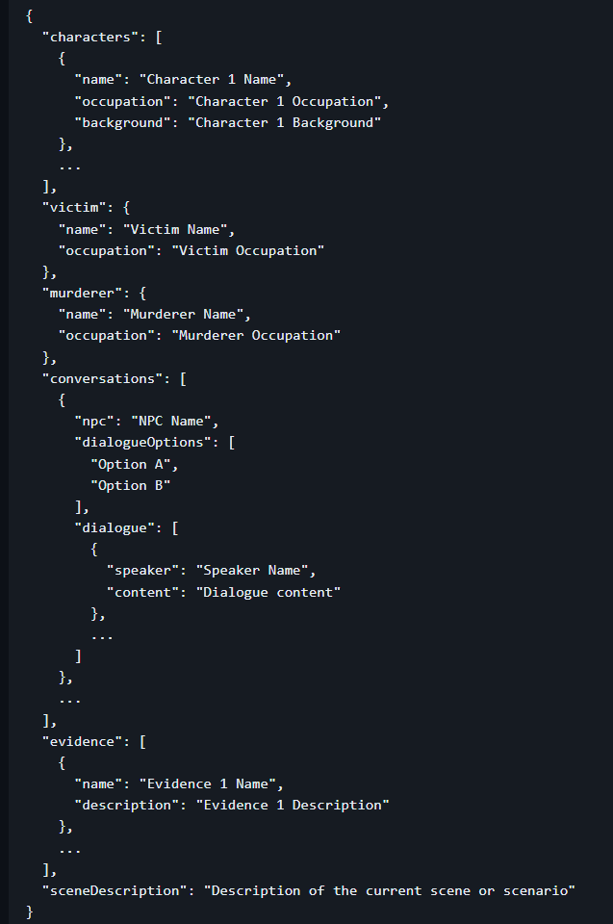
JSON Output Format

Slide 11
Game Demo

Slide 12
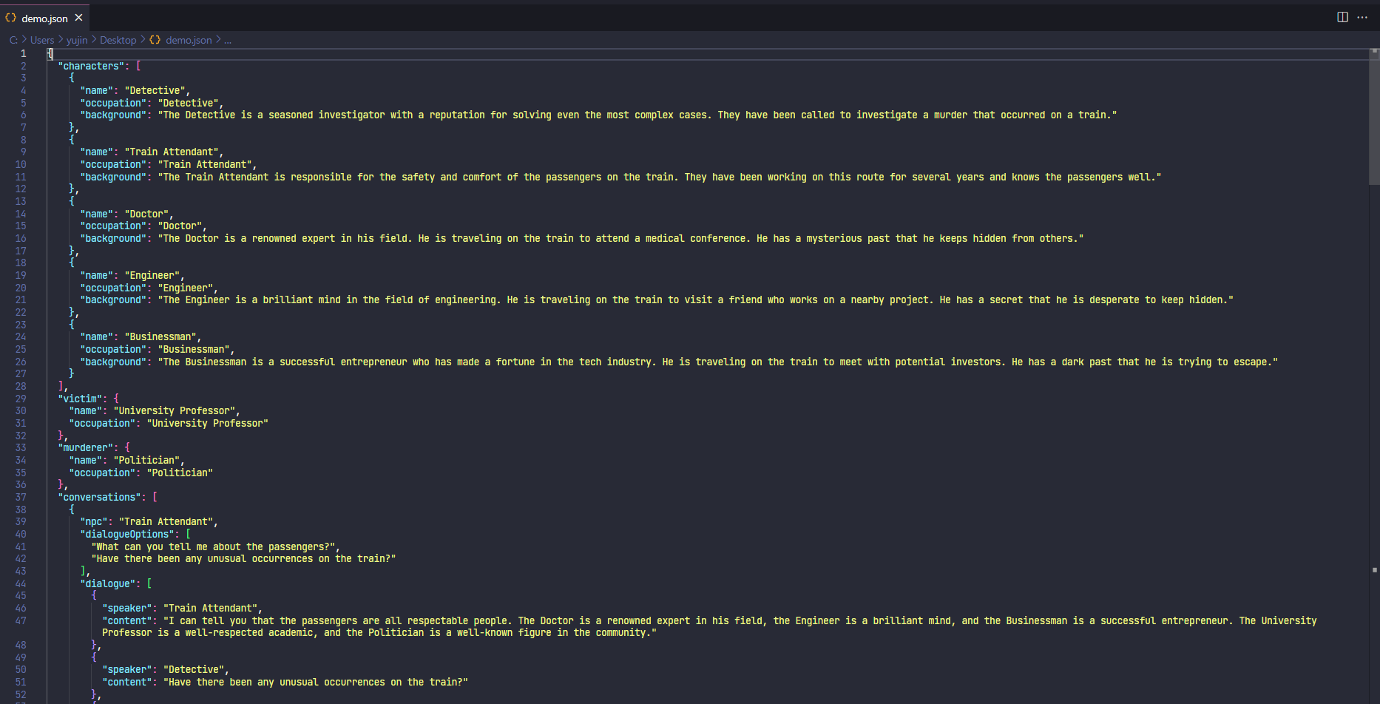

Slide 13
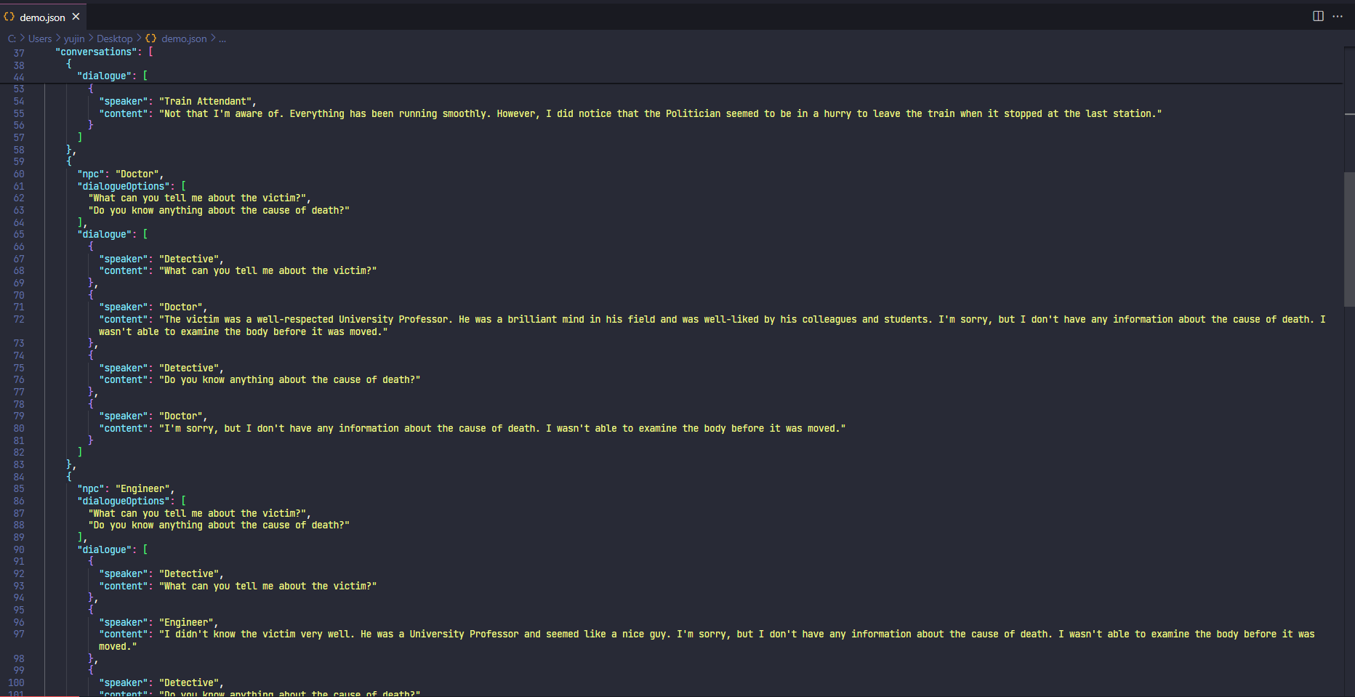

Slide 14
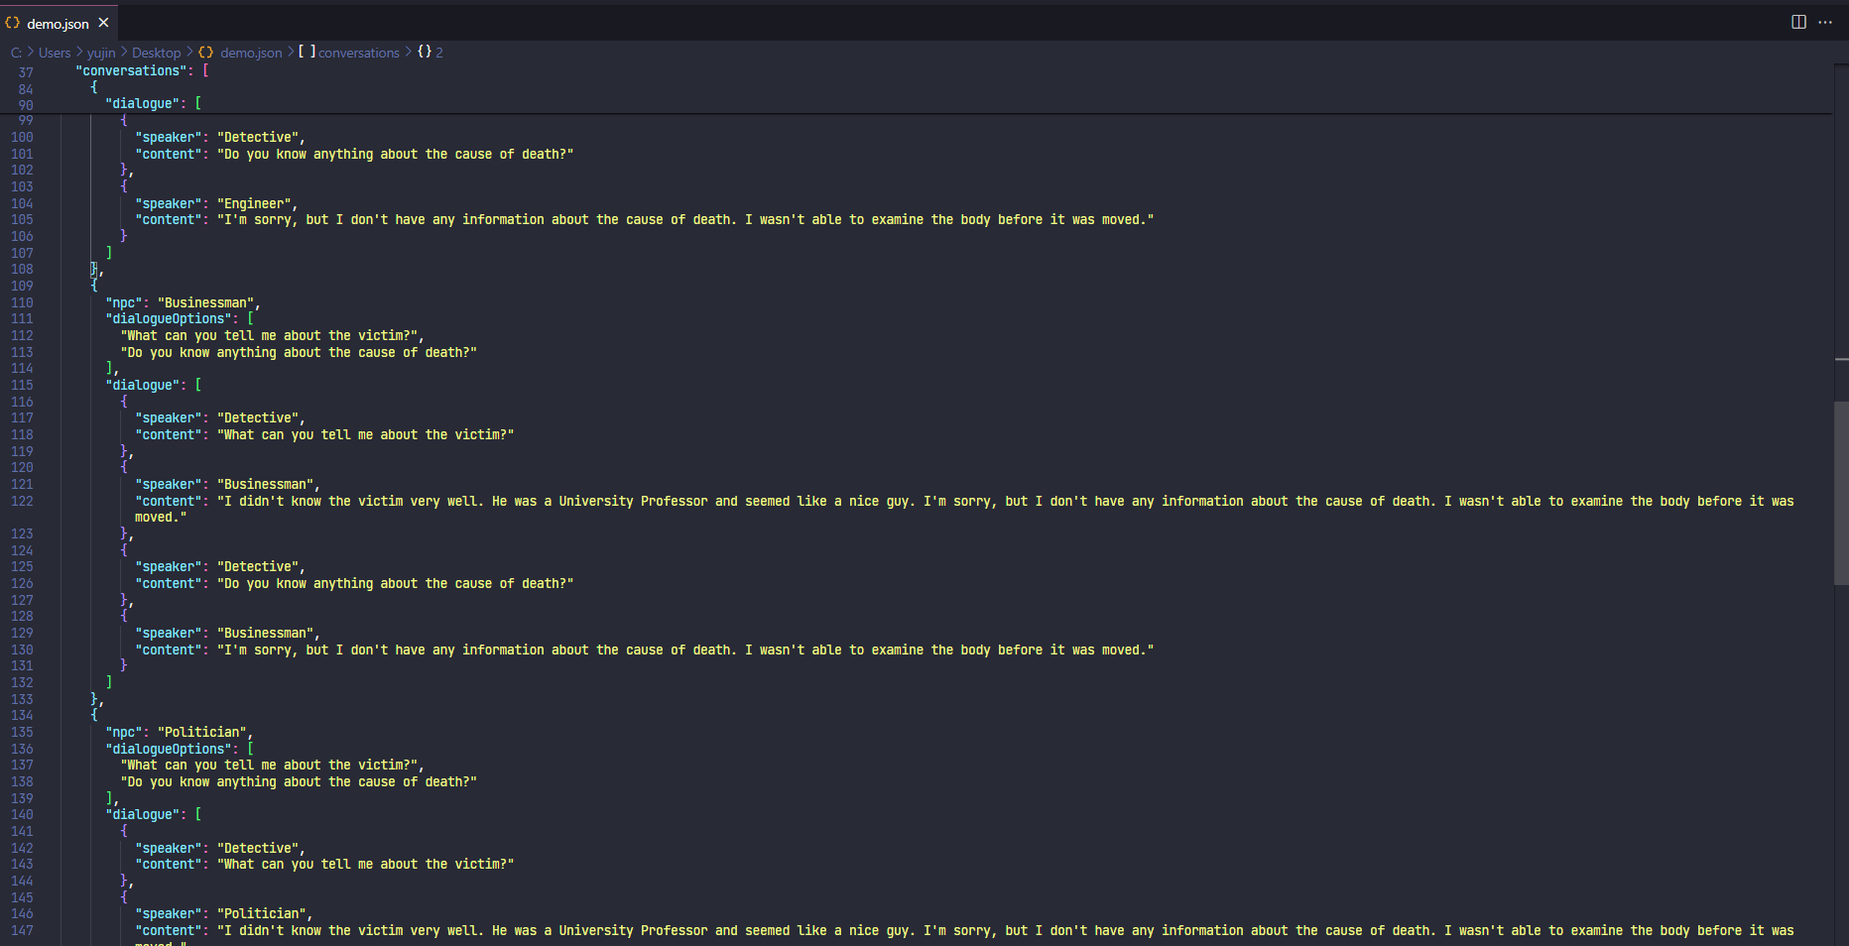

Slide 15
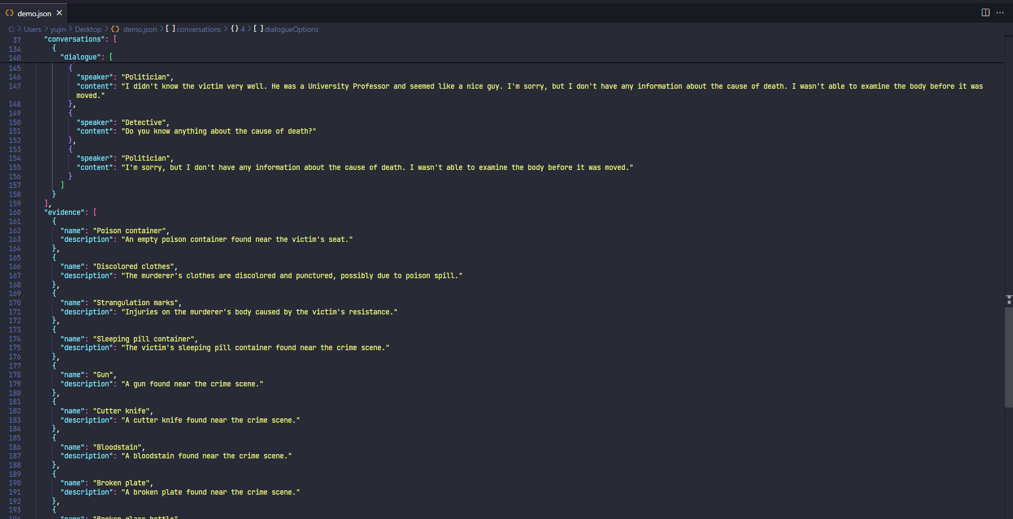

Slide 16
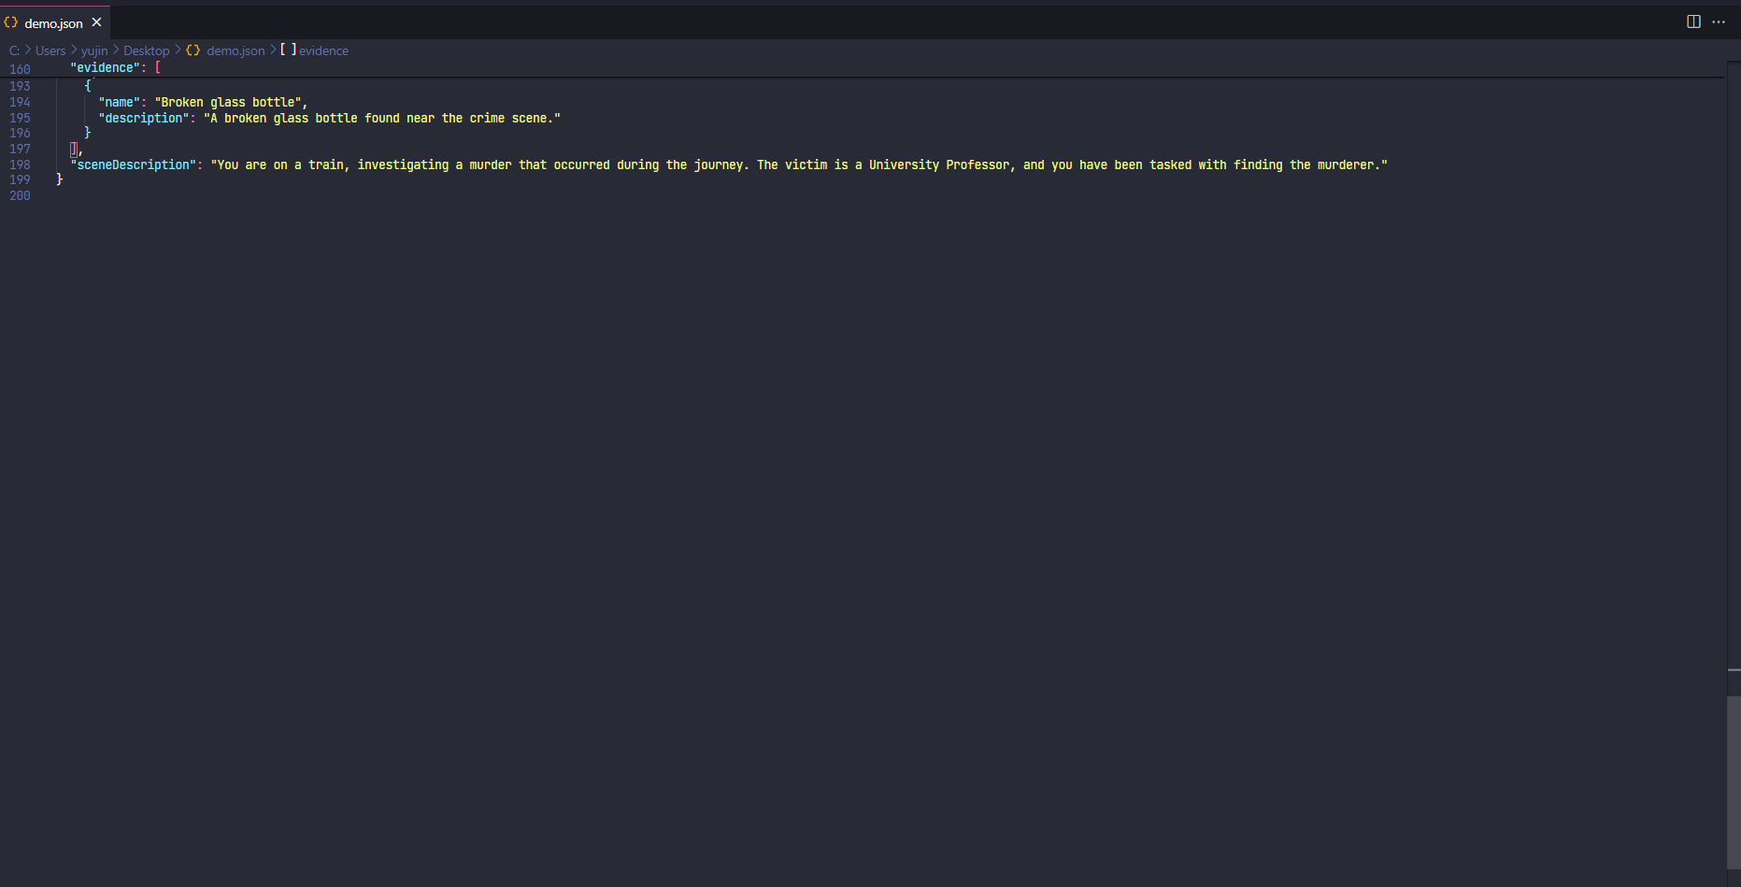

Slide 17




옥찬호 박지연 최서호 옥찬호 김유진

